Slide 1
Event Extraction
主讲人：余子健
11月23日

Slide 2
What is an event?
An event is a specific occurrence involving participants. An event is something that happens. An event can frequently be described as a change of state.
事件是涉及参与者的特定发生，事件是发生的事情，事件可以经常被描述为状态的改变。

Slide 3
What is event extraction?
Extract structured information and knowledge from unstructured data of heterogeneous data types, in various domains, genres, languages, and data modalities.

Slide 4
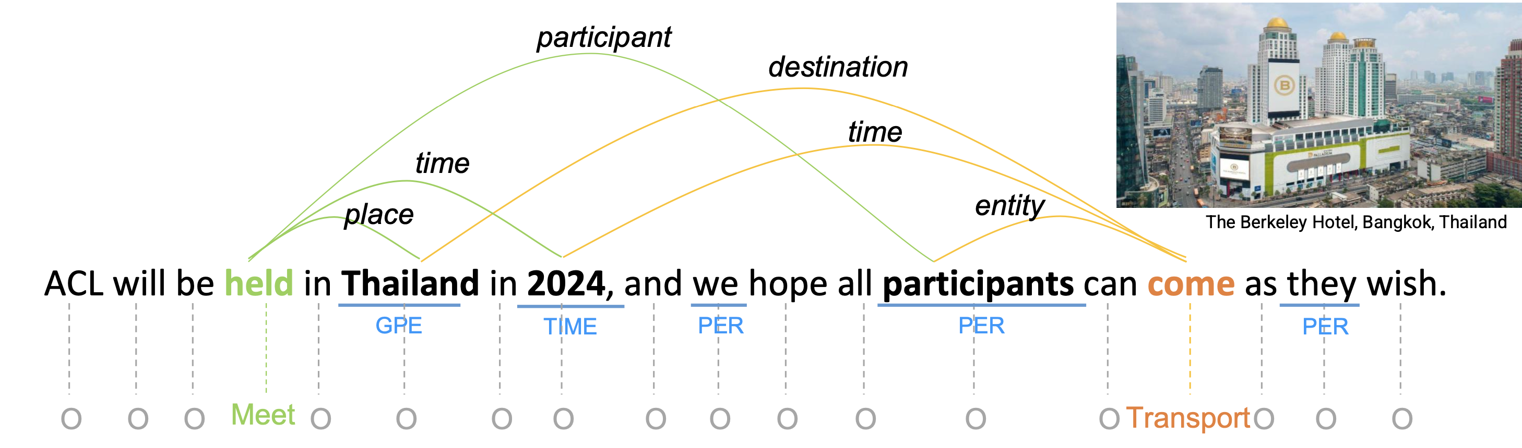
Example for EE
trigger | role | argument
held (Meet) | place | Thailand
 | time | 2024
 | participant | participants
trigger | role | argument
Come (Transport) | destination | Thailand
 | time | 2024
 | entity | participants

Slide 5
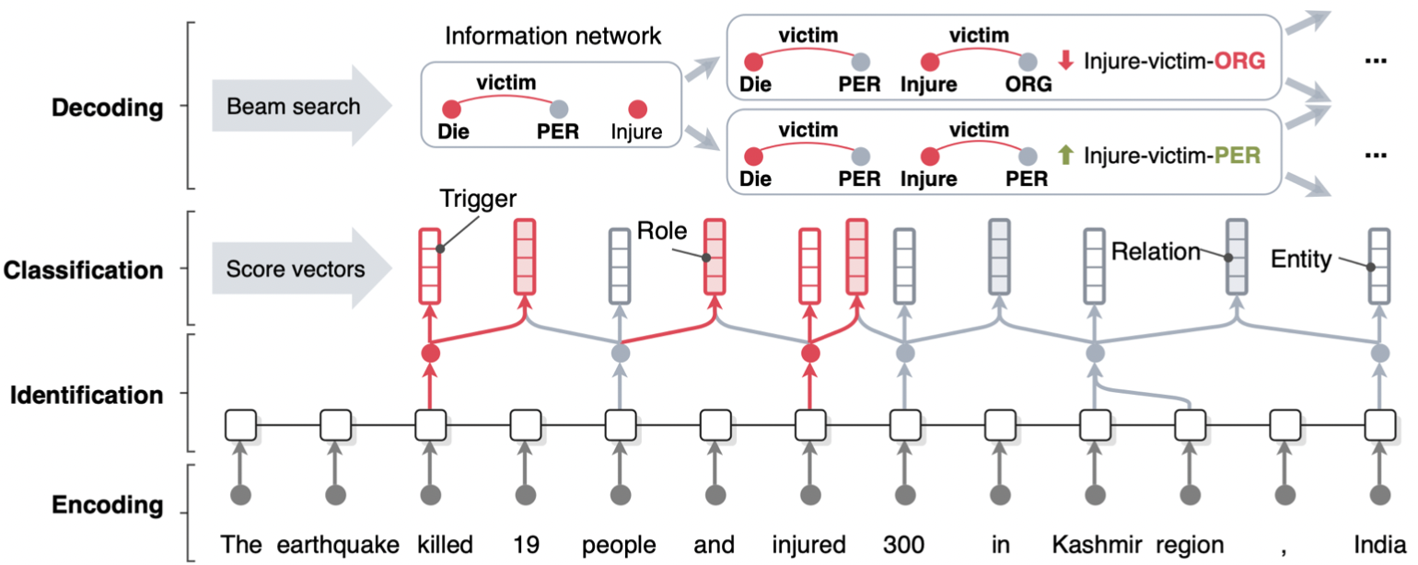
One method
An End-to-end Neural Model for IE(ONE-IE)
Ying Lin, Heng Ji, Fei Huang, Lingfei Wu. A Joint End-to-End Neural Model for Information Extraction with Global Features. ACL. 2020.

Slide 6
Challenge 1
How to encode the knowledge for better scene understanding?
semantic structure knowledge such as dependency graph, AMR graph (Abstract Meaning Representation)
document-level or corpus-level global context knowledge

Slide 7
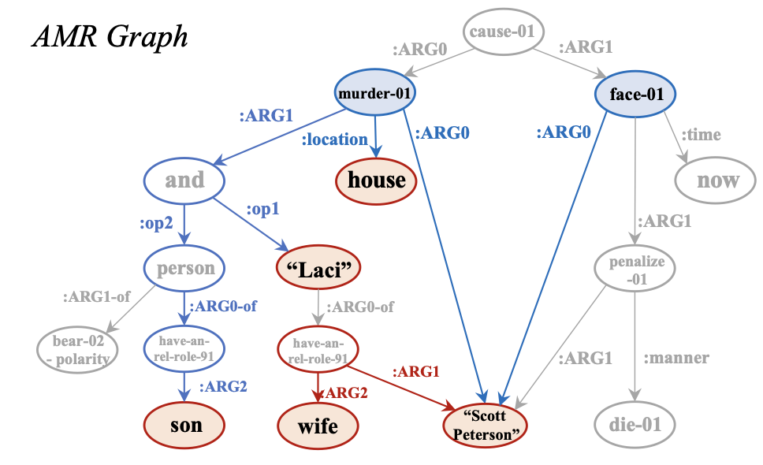
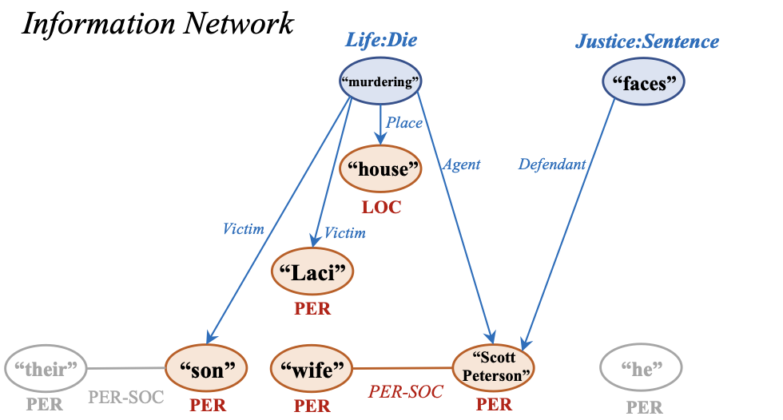
An AMR-guided framework for IE
Example: Scott Peterson now faces death penalty because of murdering his wife Laci and their unborn son at their house.
Zixuan Zhang and Heng Ji. “Abstract Meaning Representation Guided Graph Encoding and Decoding for Joint Information Extraction”. NAACL. 2021

Slide 8
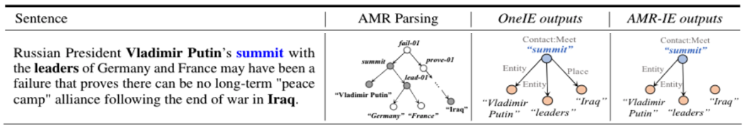
Comparison between OneIE and AMR-IE

Slide 9
Challenge 1
How to encode the knowledge for better scene understanding?
semantic structure knowledge such as dependency graph, AMR graph (Abstract Meaning Representation)
document-level or corpus-level global context knowledge

Slide 10
Extending from Sentence-Level to Document-Level
Argument Linking for Document-level IE
QA-based Event Extraction

Slide 11
Argument Linking for Document-level IE
Implicit arguments linked to explicit mentions in text
Representations: Learn span representations for each trigger span and candidate argument span
Prune: For each trigger, prune to top-K candidate arguments
Linking score: Score representations of implicit arguments with representations of explicit arguments.

Slide 12
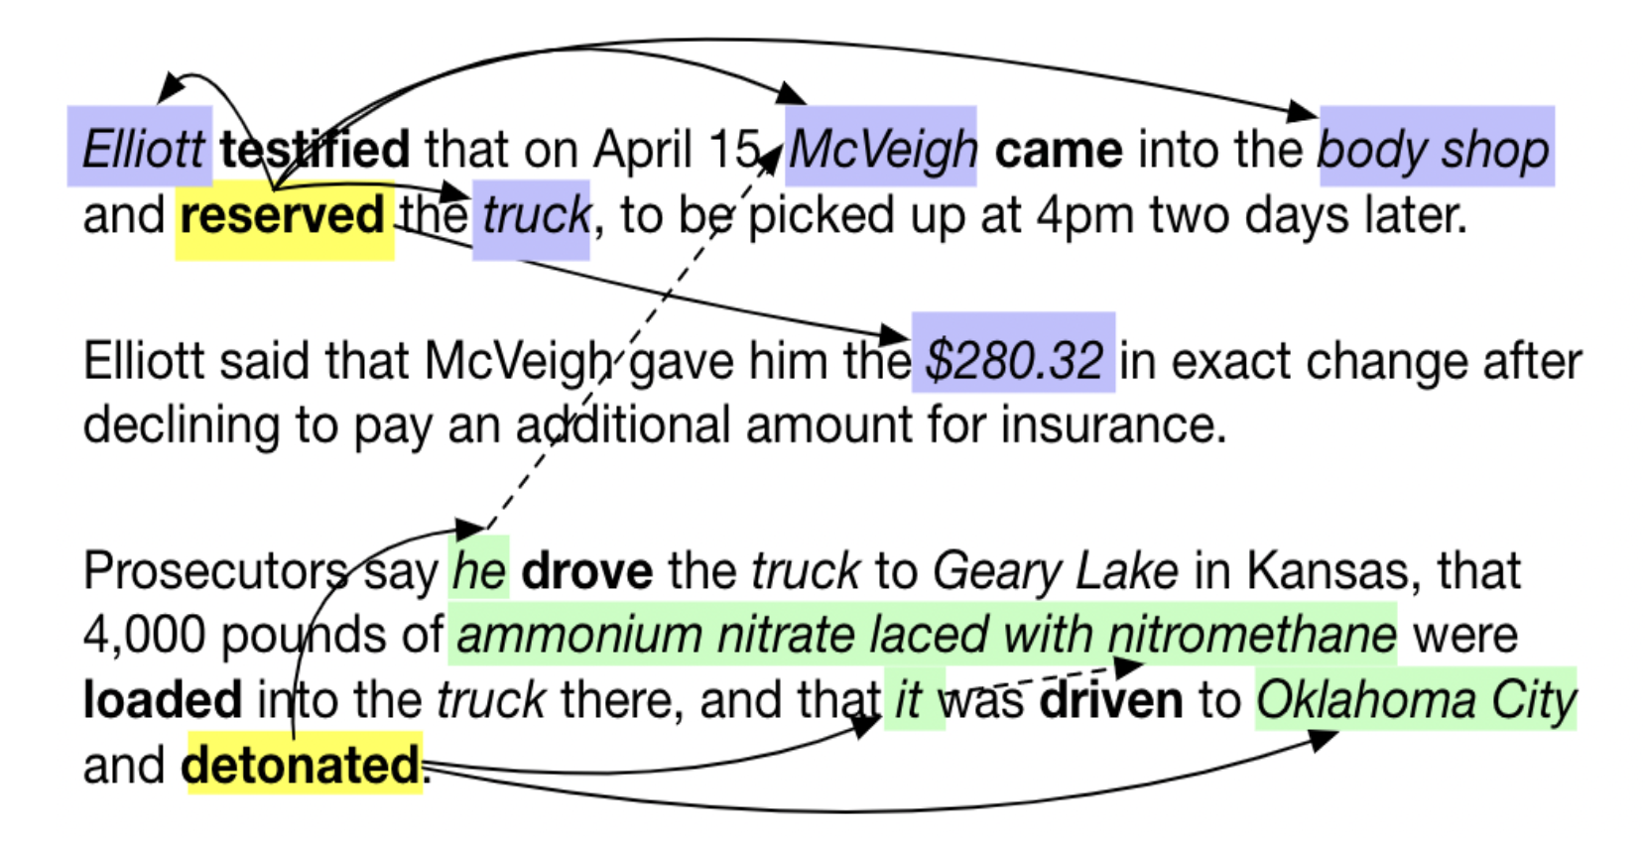
Sha Li, Heng Ji, Jiawei Han. “Document-Level Argument Extraction by Conditional Generation”. NAACL. 2021.

Slide 13
Extending from Sentence-Level to Document-Level
Argument Linking for Document-level IE
QA-based Event Extraction

Slide 14
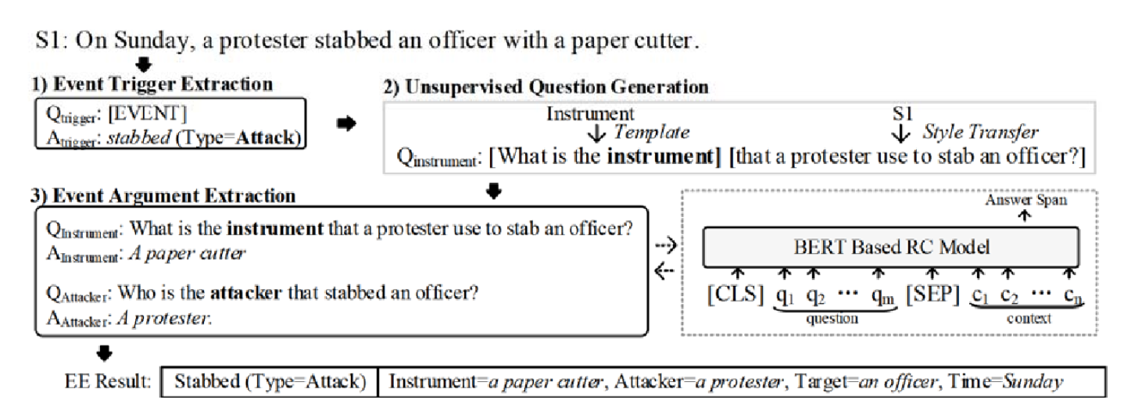
QA-based Event Extraction
Jian Liu, et al. "Event extraction as machine reading comprehension.". EMNLP. 2020.

Slide 15
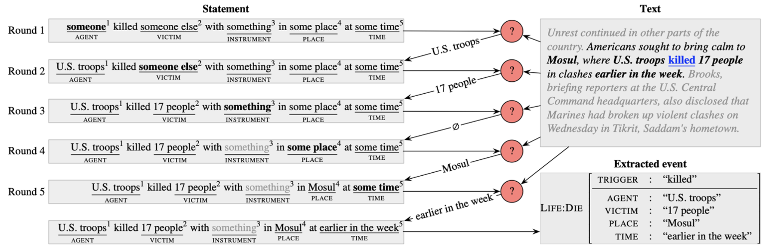
QA-based Event Extraction
Yunmo Chen, Tongfei Chen, Seth Ebner, Aaron Steven White, and Benjamin Van Durme. "Reading the manual: Event extraction as definition comprehension." ACL Workshop SPNLP. 2020.

Slide 16
Challenge 2
How to improve portability?
cross-domain
cross-lingual
cross-media

Slide 17
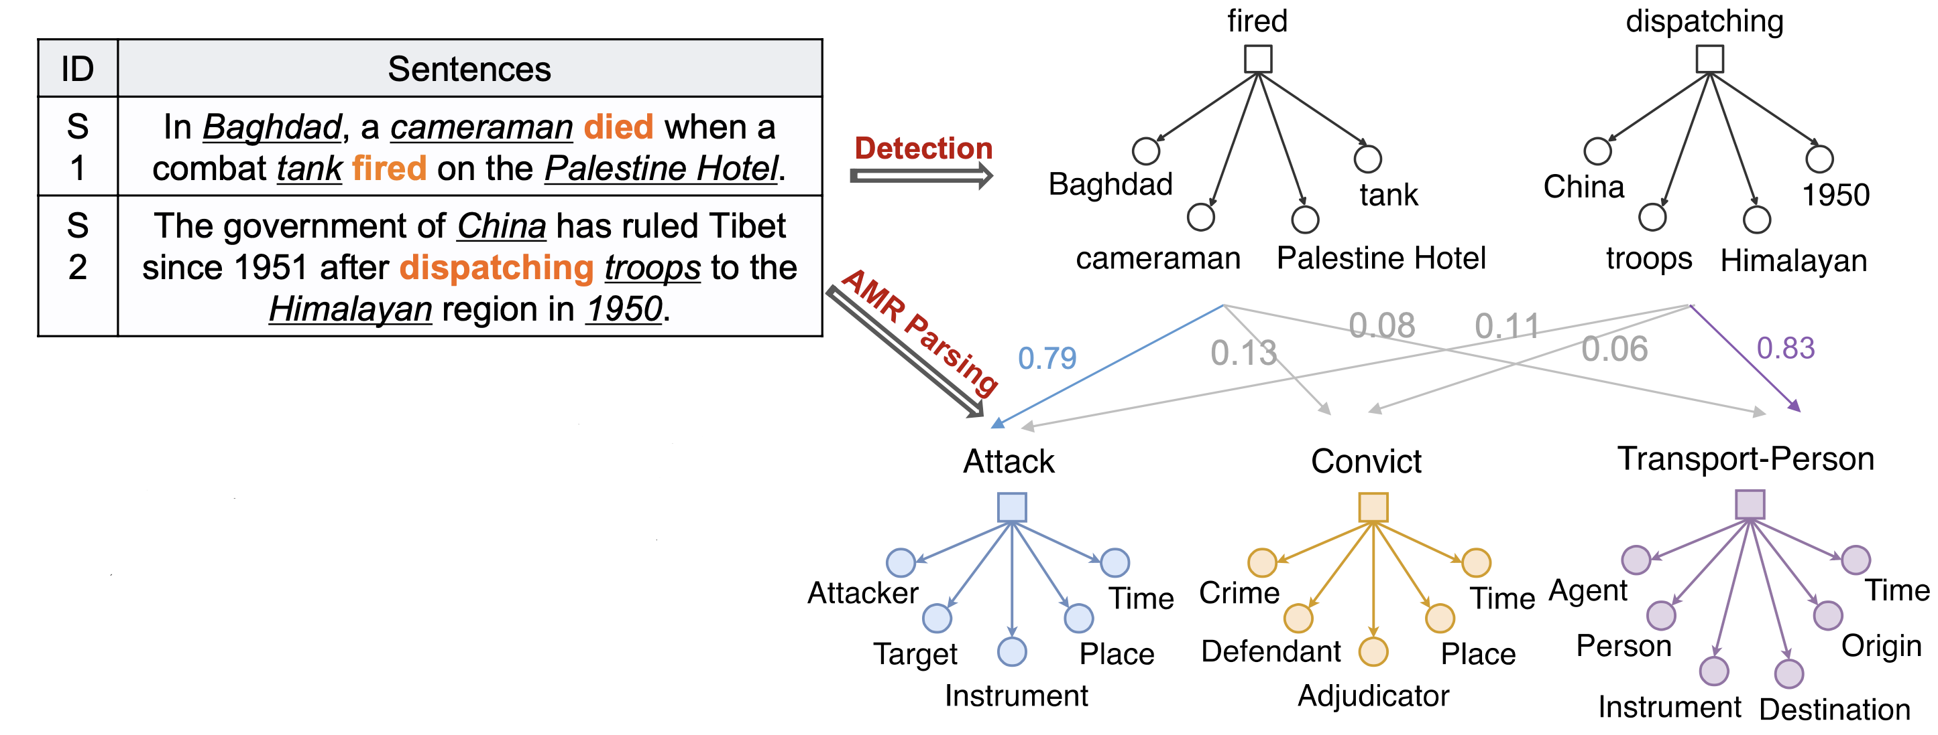
Building a shared representation (semantic common space)
Lifu Huang, Heng Ji, Kyunghyun Cho, Ido Dagan, Sebastian Riedel and Clare Voss. 2018. “Zero-shot transfer learning for event extraction”. ACL. 2018.

Slide 18
Contrastive Pre-training for Event Extraction (CLEVE)
To train a more structure-aware common space with large-scale dataset, contrastive learning is proposed to represent the words of the same events closer than those unrelated words; Graph contrastive pre- training to learn event structure representations on event related AMR structures

Slide 19
Challenge 2
How to improve portability?
cross-domain
cross-lingual
cross-media

Slide 20
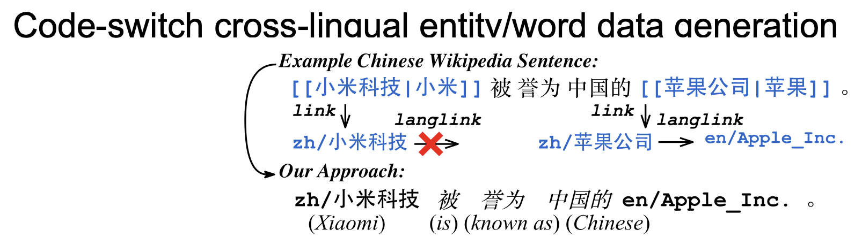
cross-lingual
Pan, Xiaoman, et al. "Cross-lingual joint entity and word embedding to improve entity linking and parallel sentence mining." EMNLP Workshop DeepLo. 2019.

Slide 21
Challenge 2
How to improve portability?
cross-domain
cross-lingual
cross-media

Slide 22
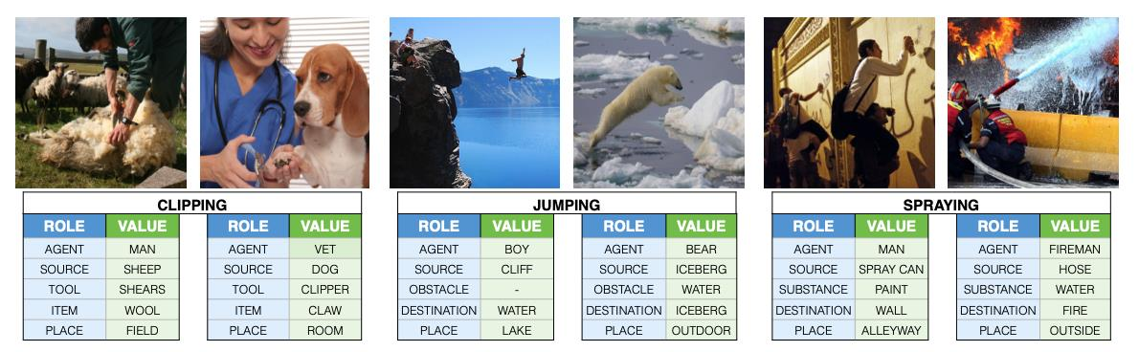
Cross-media
Sarah Pratt, Mark Yatskar, Luca Weihs, Ali Farhadi, Aniruddha Kembhavi. “Grounded Situation Recognition”. ECCV. 2020

Slide 23
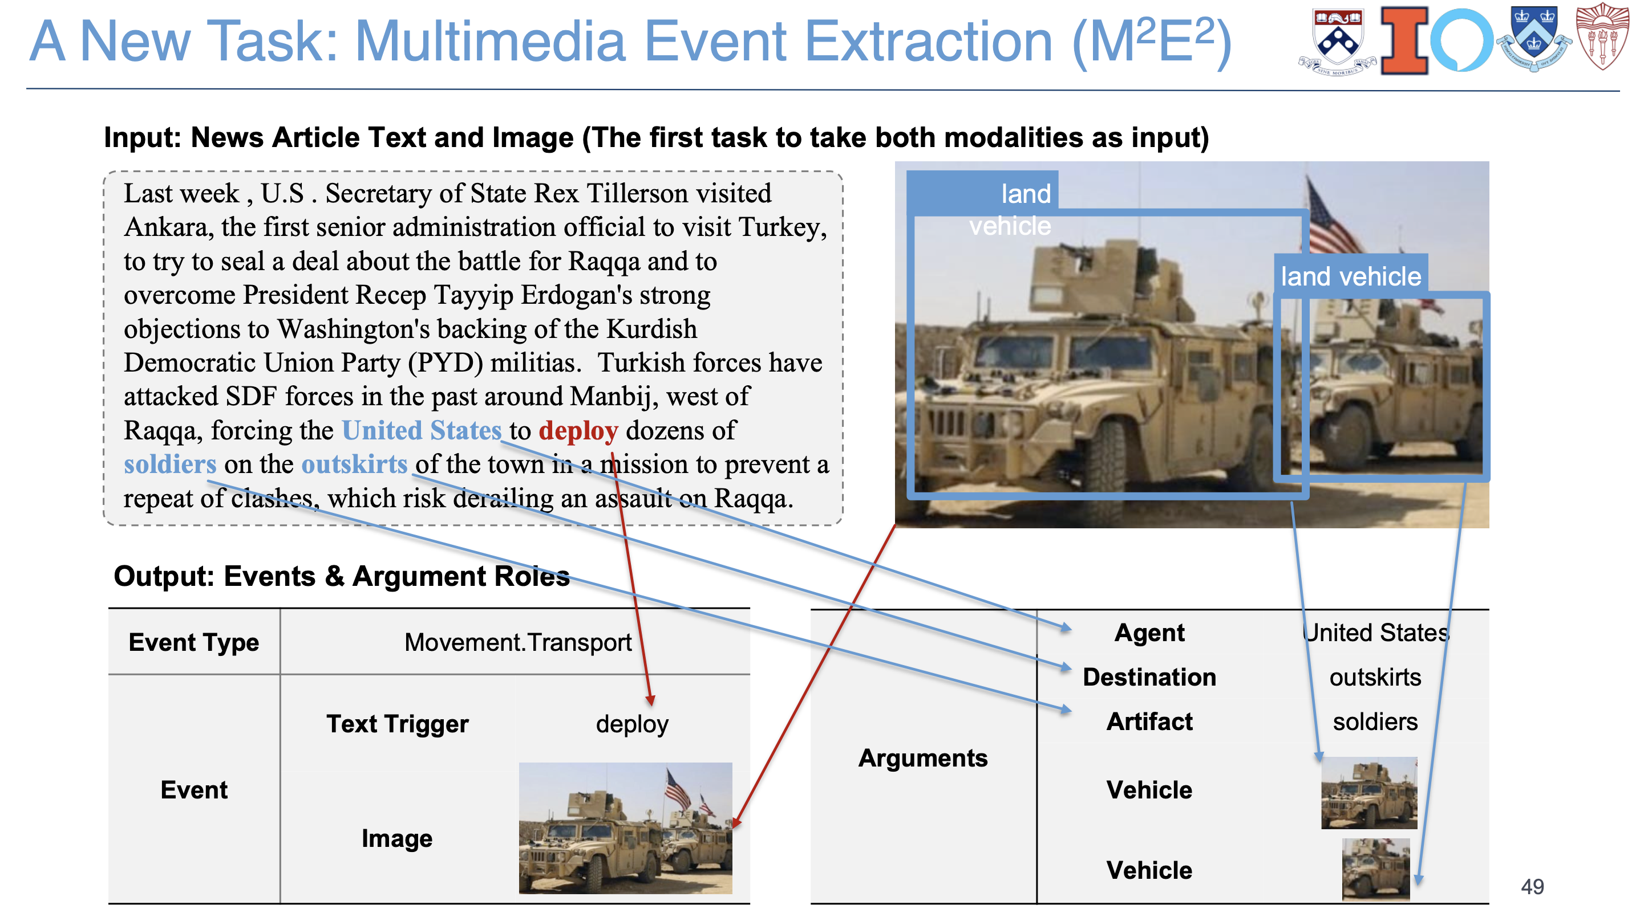
Alireza Zareian, Svebor Karaman, Shih-Fu Chang. “Weakly Supervised Visual Semantic Parsing”. CVPR. 2020

Slide 24
Thanks

